Slide 1

GRAPHIC DESIGN
PORTFOLIO
Creating Visual Stories
Our Ongoing Work

Slide 2
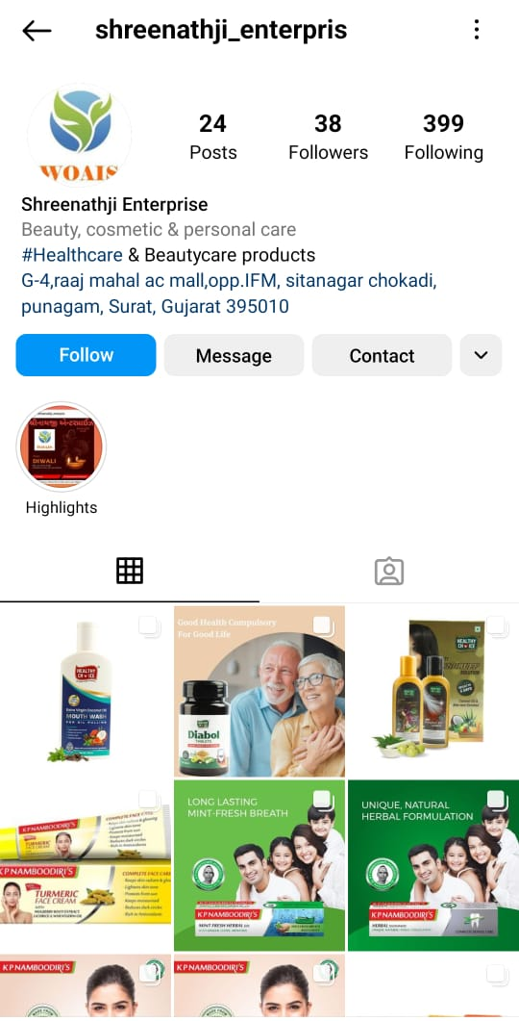


Marketing & Advertising

Slide 3
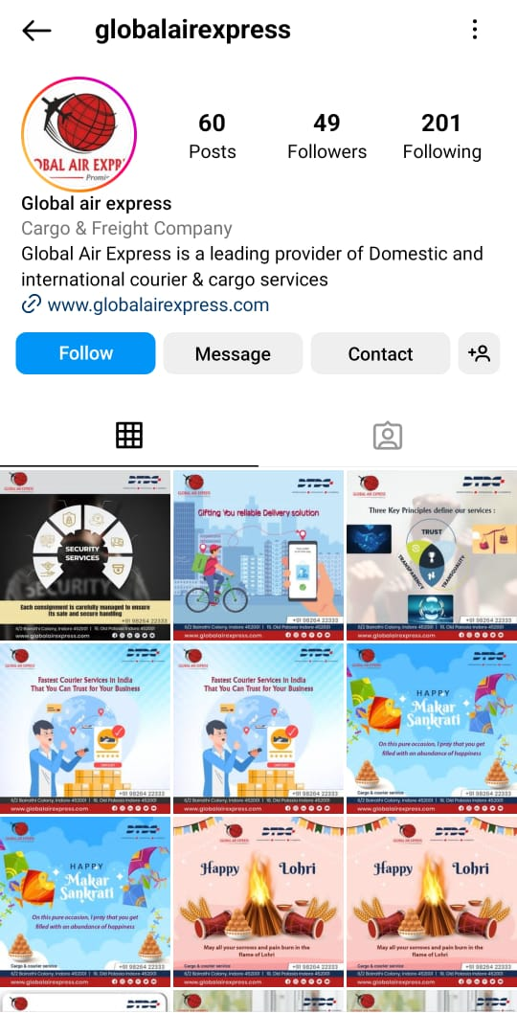



Slide 4
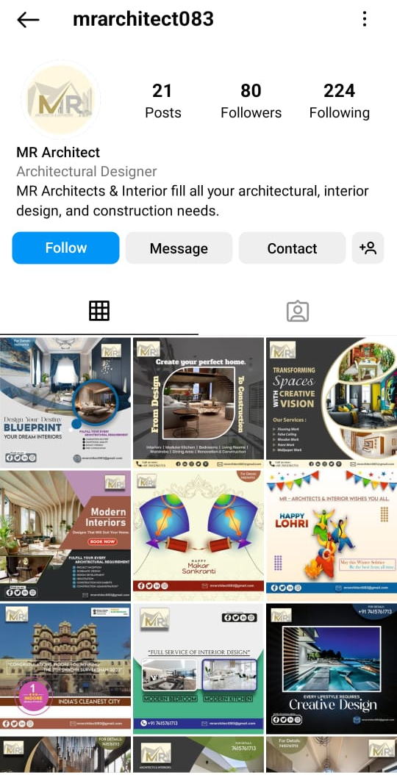



Slide 5
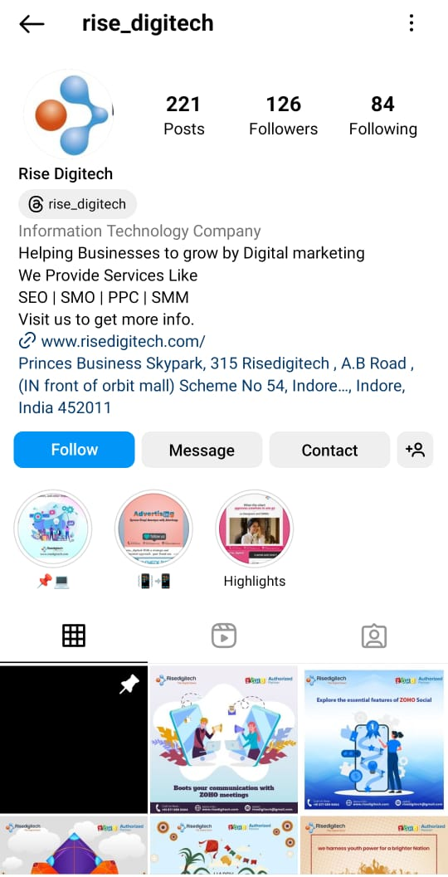



Slide 6




Slide 7
